Slide 1
Group 11 Presentation
MSCI151 Group Methex 1
Notes:
Introduce everyone and what they will talk about

Slide 2
Introduction
Determine optimal ordering policies for 3 different scenarios for a shop
Set up simulations for each part using excel
Calculated optimal values and then tested values around these values
Drew conclusions based on results

Slide 3
The Simulation Model
The simulation model for both the Sprint and Vitality drinks include the day, inventory at the start of the day, any deliveries arriving for the day using the formula COUNTIF($M$4:M4,A5)*$Q$13 to check in the day received column whether any deliveries are arriving on the day, and how many units will be arriving
Then there is the available stock, which is the inventory at the start of the day plus the deliveries (if any are arriving on the day)
Then we added the demand and demand satisfied column using the formula MIN(D5,E5) to see whether the demand is lower than the stock and if all order have been fulfilled for the day

Slide 4
The Simulation Model
The next column is end inventory with the formula MAX(D5-E5, 0), and this calculates the inventory at the end of the day once all orders have been fulfilled
The shortage column is next using the formula (MAX E5-D5, 0) which calculates is there were any shortages and how many by subtracting the demand from the available stock
The formula used for the stockout column is IF(H5>0, 1, 0) and this calculates whether the available demand was enough to satisfy the demand

Slide 5
The Simulation Model
The formula for the end inventory + order column is J4-F5+IF(K4=1, $Q$13, 0) and this calculates the inventory at the end of the day as well as adding the orders awaiting arrival
The next column is the order column, and it determines whether a new order should be placed according to the stock in the end inventory and order column, and whether it is lower than the re-order level or not. It uses the formula IF(J5<=$Q$12, 1, 0)
The next column is the lead time column which determines how many days the delivery will take if one is placed, using probability and random distribution, and the formula IF(K5=1, LOOKUP(RAND(),$R$4:$R$5,$P$4:$P$5), 0). (A bit more on this later)

Slide 6
The Simulation Model
The next column is the day received column which provides the day on which the delivery will arrive if one is placed, and uses the formula IF(K5=1, L5+A5+1, “N/A”) to add the lead time to the current date if an order is placed
The final column is the cost column which calculates the total cost for the day using the formula (G5*$Q$14) + IF(K5=1, $Q$15+($Q$13*$Q$16), 0) + (H5*$Q$16) This adds the holding cost of per unit for however many units are in the end inventory, the stockout cost (if applicable), and if any order were placed it adds the order cost of £30 as well as the order cost per unit

Slide 7
The Simulation Model
Another important point is that all simulations had 100 replications performed
To use these values a so called ‘average average daily cost’ was used to ensure that the results were accurate

Slide 8
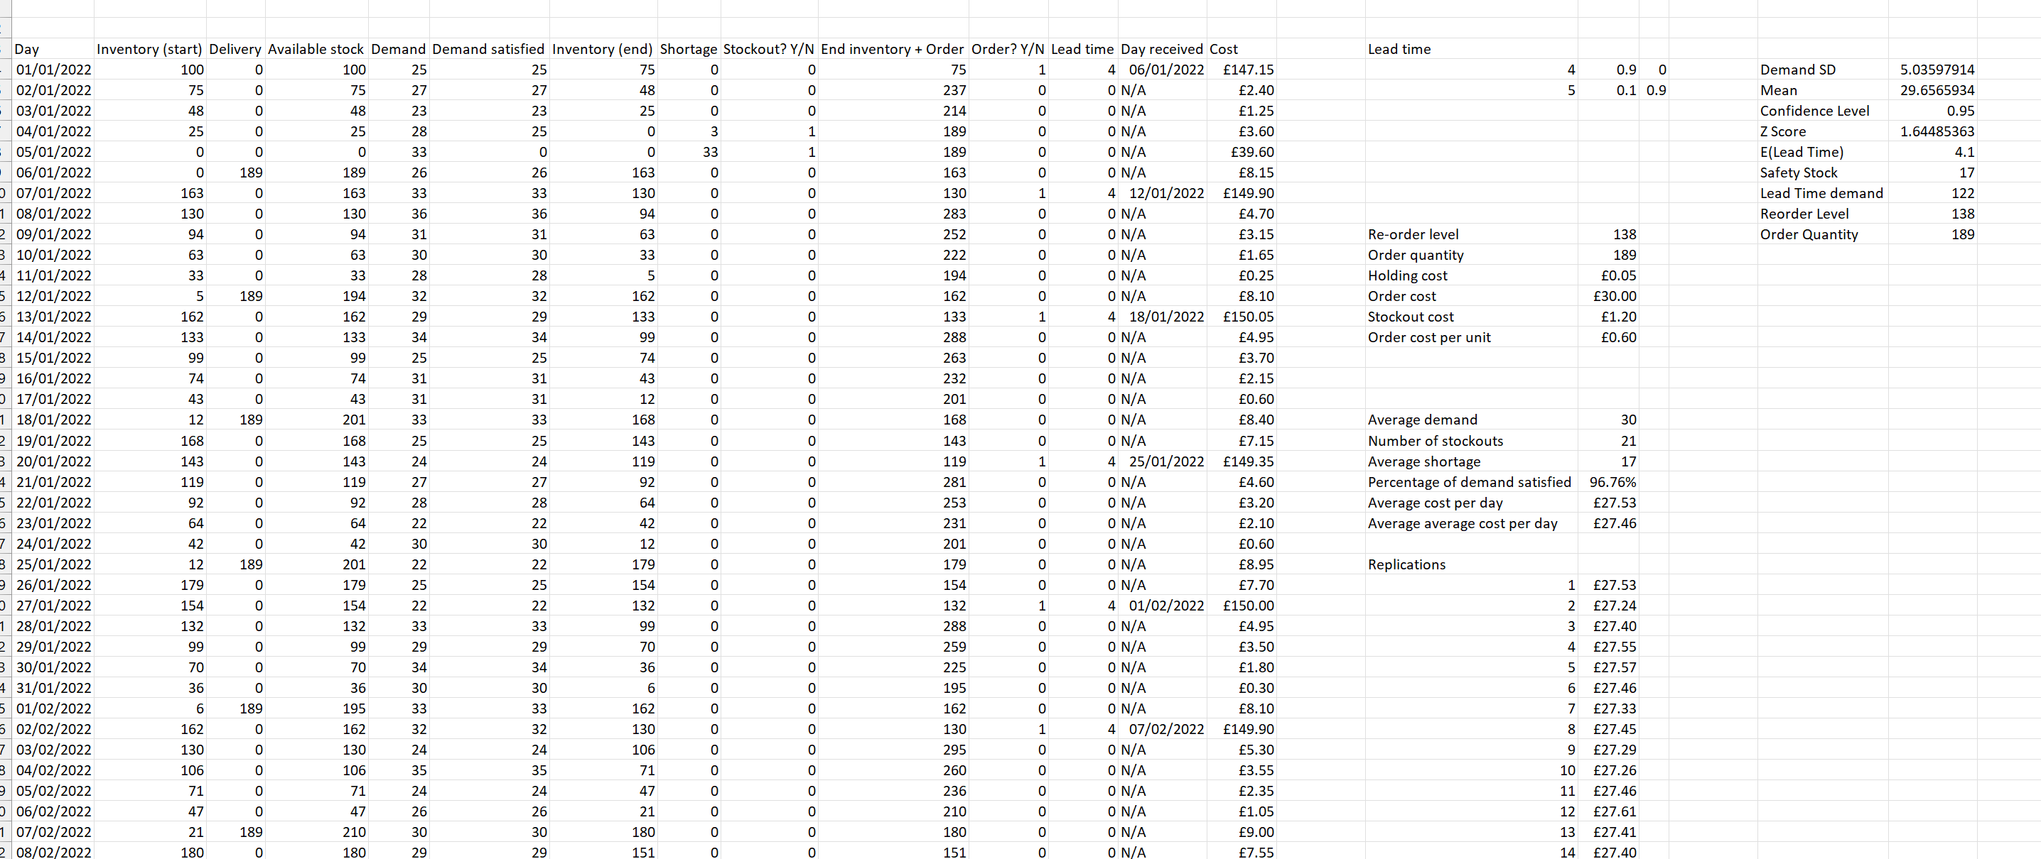
The Simulation Model

Slide 9
Calculating Lead Time
Looking at Sprint, however the same method applied to the rest of the simulations
The lead time for the Sprint drink was calculated using the given probabilities of 90% for a lead time of 4 days and a 10% chance of a lead time of 5 days
We created a table using these probabilities and used the RAND() function in the lead time column to generate a random number between 0 and 1
We then used the LOOKUP function refer back to the table created, and values between 0 and 0.89 would give a lead time of 4 days and values between 0.9 and 0.99 would give a lead time of 5 days

Slide 10

Ordering Policies – First Approach
Trial and error was not an efficient way to find optimal values for reorder levels and quantity due to the wide range of possibilities with two variables
Therefore, we calculated theoretically the optimal values for Order Quantity and Reorder Level
Economic Order Quantity =$\sqrt{\frac{2∗Fixed Order Cost∗Average Demand}{Holding Cost per Unit}}$
Reorder Level = $Safety Stock+Lead Time Demand$
Safety Stock = $\sqrt{E\left(Lead Time\right)}∗Zconfidence∗σdemand$
Lead Time Demand = $E\left(Lead Time\right)∗Average Demand$
Notes:
Use of expected lead time to account for the changing lead times

Slide 11
Ordering Policies – Second Approach
Applied skills from the workshop to use a solver to find the optimal reorder and quantity levels for both Sprint and Vitality respectively
Objective of the solver is set to minimize the value of cell which is summation of daily costs
The variable cells changed are the order quantity and reorder levels
Added constraint for order quantity and reorder levels to be integers to be a suitable solution
GRG Nonlinear solving method used as this was used in workshop to obtain optimal values
Interestingly, our calculated values were very close to the solvers’ optimal values. For Vitality, they were the same

Slide 12
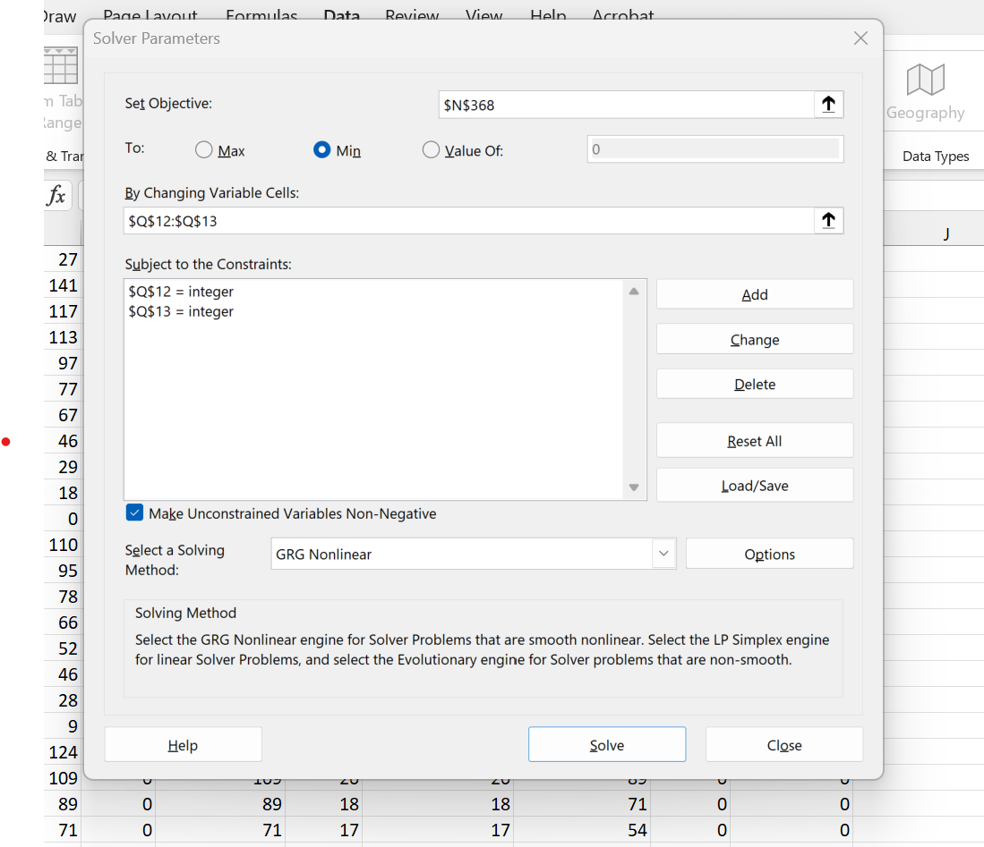
Ordering Policies – Second Approach

Slide 13
Ordering Policies – Final Values
Once we had the solver’s optimal values for the Average Daily Cost, we then played around with the number manually to try and then minimise the number of stockouts low and maximise the percentage of demand satisfied as high as possible.
This led to some slight changes in values, but we decided not to stray too far from the Average Daily Cost optimal value as this was what the store was primarily interested in
The exercise could be run again to focus more on these other factors should the store require it

Slide 14
Conclusions – Part A
Concluded that the optimal values were:
Sprint
Reorder Level = 151
Order Quantity = 185
Average Daily Costs = £27.71
Vitality
Reorder Level = 66
Order Quantity = 130
Average Daily Costs = £21.73

Slide 15
Conclusions – Part B
Concluded that the optimal values were:
Sprint
Reorder Level = 74
Order Quantity = 218
Average Daily Costs = £28.53
Despite a slightly higher average cost, we would recommend the store to order from Supplier C as the number of stockouts were reduced.

Slide 16
Conclusions – Part C
Using the optimal values discovered in Part A, the model was applied with policy being more heavily thought about.
The best policy was as follows:
When one drink falls below its reorder level, an order is placed for the reorder quantity of that drink
Then reorder the other drink at a quantity equal to
Standard Order Quantity – (Stock Level – Reorder Level)
This minimises the number of orders hence minimising the number of orders required hence minimising fixed order cost.

Slide 17
Part C Example
 | Sprint | Vitality
Order Quantity | 185 | 130
Reorder Level | 151 | 66
With Standard Values:
Day | Sprint Stock | Vitality Stock | Reorder Needed (S/V) | Order Quantity S | Order Quantity V
01/06/2022 | 210 | 79 | No | 0 | 0
02/06/2022 | 190 | 57 | Yes (Vitality) | =185-(190-151) =146 | 66

Slide 18
Recommendations
From parts A, our final recommendation to the store would be to purchase from Supplier A and B with the Ls, Lv, Qs, Qv values given previously. Should supplier C be available to order from as in Part B, we would suggest that the store does so.
Should suppliers A and B merge as they do in part C, our recommendation would be to order on a model as given, by adjusting the order levels to suit the current inventory level.
Obviously, all of these recommendations are based on a previous years’ data so the store needs to be aware that demand may vary.

Slide 19

Any questions?

